Slide 1

Microsoft Entra Permissions Management
Remediation & Permissions Creep Index
<Name>
<Job role>

Slide 2
Agenda
Planning Phase
Remediation Phase
Day 0
Immediate actions
Day 30
Baselining
Review Findings
Implement JIT/JEA
Permissions Creep Index (PCI)
What is it?
What does it identify?
PCI heat map

Slide 3
Planning Phase

Slide 4
Reminder on Zero Trust
Least privilege best practices
Right-sizing permissions assignments
Assign least privilege roles and continuously review assignments and historical usage to adjust over time
Avoid direct assignment of users to high-risk roles
Implement permissions-on-demand (just-in-time) elevation of privileges for high risk tasks in GCP and AWS
Implement PIM for Groups or EPM permissions-on-demand elevation of privileges for high risk tasks in Azure
Carefully design access to production environment!

Slide 5
Remediation plan
Prioritize and triage - some tasks are more immediately important than others:
Day 0: Immediate attention needed
Critical ports open to the Internet (e.g. 22 – SSH, 3389 – RDP, 1433 – SQL Server, 3306 – MySQL Server, etc.)
Data exposed externally/publicly from blob storage
Day 30: Getting to an improved baseline - this phase aims to create a baseline with most of the findings remediated
Enable Controller Mode on Authorization Systems
Evaluate other EPM Findings, formulate a plan for which can be right-sized
Execute on plan to right-size roles/permissions identified for users, groups, and service accounts / apps based on initial EPM findings
Define the policies and establish process for permissions on demand flows.
Day 60: Plan and Alert – “Stop the Bleeding”
Capture your current state using PCI Dashboard
Configure Alerting so you know if any new findings are springing up
Continue remediation activities from findings
Day 90: Leverage Automation
Implement autopilot rules
Operationalize SOC processes around alerts
Force users to leverage permissions on demand
Report on progress using PCI Dashboard – are you seeing improvements you can show to management?

Slide 6
Remediation Phase

Slide 7

Day 0 Remediations: Fix the immediate problems

Slide 8
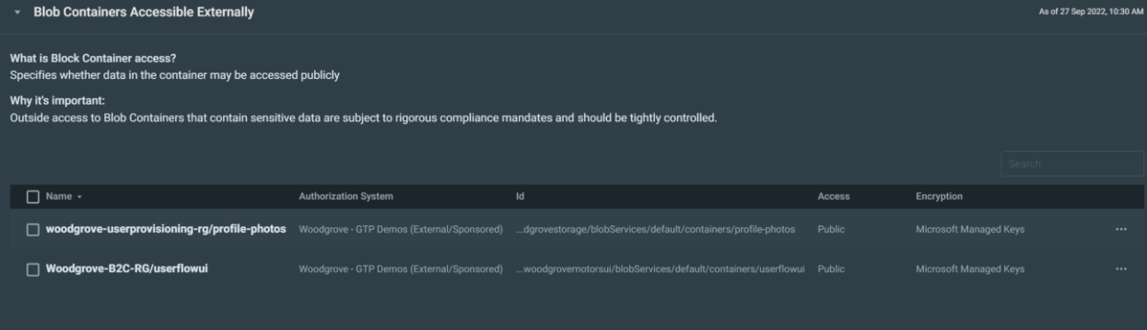
Immediate action: Data that is accessible externally
Risk: Carefully review all findings for data that is exposed publicly (Azure Blob storage, AWS S3 buckets, GCP Storage buckets)
Action: Using the permissions analytics report, identify those storage accounts (S3 Buckets, Storage buckets) and make sure to configure the right access and exposure level.

Slide 9
Immediate action: Open network security groups
Network security groups can have critical ports open for inbound connections from the Internet
Ports like 22 (SSH), 3389 (RDP), 1433 (SQL Server), 3306 (MySQL Server) and others must be protected from direct Internet access.
Action: Close completely these ports from Internet. Typically done via a policy tool, such as Azure Security Center or AWS security group rules.
Network security groups with no resources behind them create future hidden risks
Action: Identify owners and review those network security groups. Remove those that are not needed anymore.

Slide 10

Day 30 Remediations: Get to a Baseline

Slide 11
Getting to baseline tips
Find the right stakeholders and verify before taking action
Most resources in an environment are used by different teams within a company. Before changing permissions first identify the stakeholders and discuss the findings
Be aware of seasonal access, especially for application identities
Verify if read-only access is enough
After assigning read-only access, test the application
Entra Permissions Management reports are most accurate about 60 days after first onboarding of an authorization system
By initial onboarding only data over the last 30 days is available
Depending on the type of authorization system (Azure, AWS, GCP) read operations might not be tracked. Consider this information when reviewing “inactive” identities – they might need read only access
Future projects (landing zones) could require more permissions than the baseline

Slide 12
Review super identities
It is expected to have “super” identities
Users, Groups, Apps / Service Principals, Serverless Functions
It is NOT expected to have excessive numbers of super identities
Generally want 5 or fewer User and/or Group super identities per authorization system
App / service principal / service accounts should be very limited in number and reasoning for permissions documented
Recommendation:
Move permissions for super users and groups to JIT (PIM for Azure, EPM JIT for AWS, GCP, and Azure)
PIM for Groups is very standard for Azure RBAC role-management. Many of the benefits of EPM JIT are already in place if you are already using PIM for Groups
EPM JIT extends similar Just-in-Time concepts to AWS and GCP quickly and easily

Slide 13


JIT / JEA
PIM Approval process
Azure AD
Privilege Management at Scale
Leverage JIT/JEA controls for Tier 0 roles, expand to other roles as well.
No Persistent Elevated Access
Do not allow persistent elevated access on-premises or in the cloud.
Reduce Surface Area
Significantly lower blast radius if identity is compromised.
Request access
Manager Approval
Elevated access
Azure AD JIT elevation
Entitlement flow
Privileged Admin Workflows
Azure Subscriptions
Azure AD PIM
CORP
Partners

Slide 14


JIT / JEA
PIM Approval process
PIM Approval process
Azure AD
Request access
Manager Approval
Request access
Manager Approval
EPM JIT elevation
Elevated access
Elevated access
Azure AD JIT elevation
Entitlement flow
Entitlement flow
EPM JIT Workflow
Privileged Admin Workflows
Azure Subscriptions
EPM JIT elevation
CORP
Partners

Slide 15
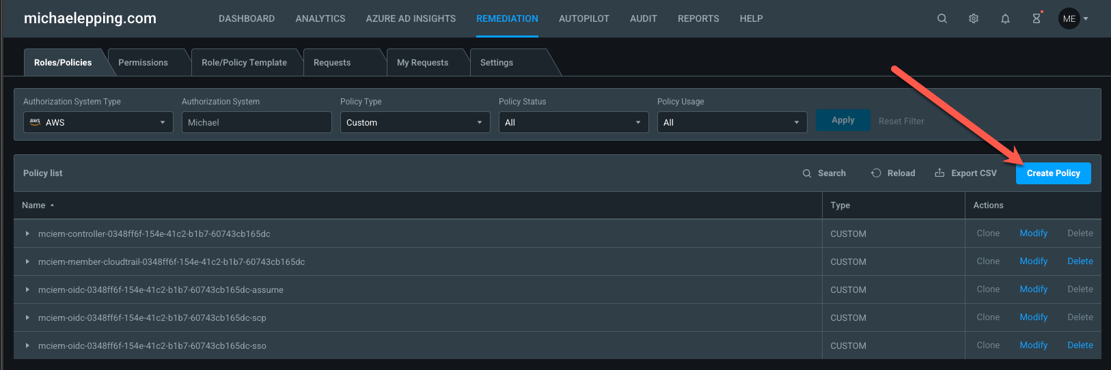
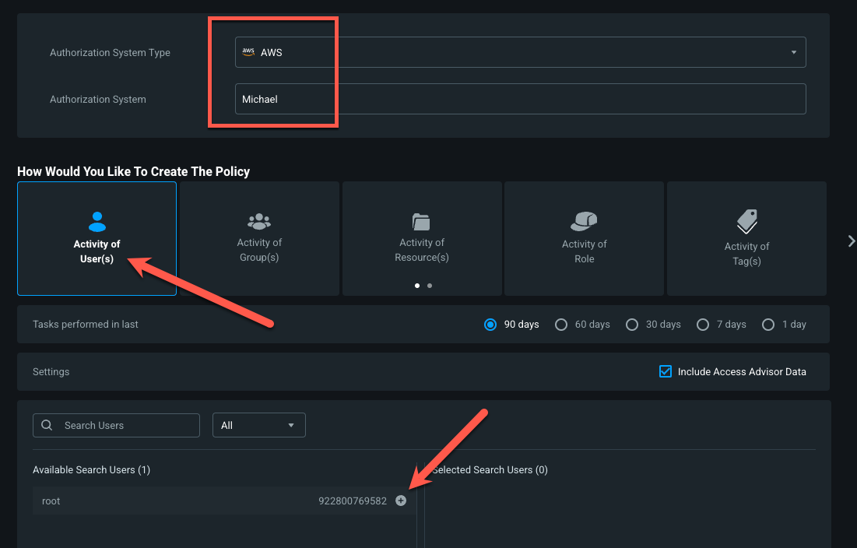
Configuring EPM JIT for Super Identities
Navigate to Remediation → Roles/Policies → Create Policy
Select your Authorization System Type and Authorization System
Select Activity of User(s) and choose the Super Identities you’re converting to JIT access

Slide 16
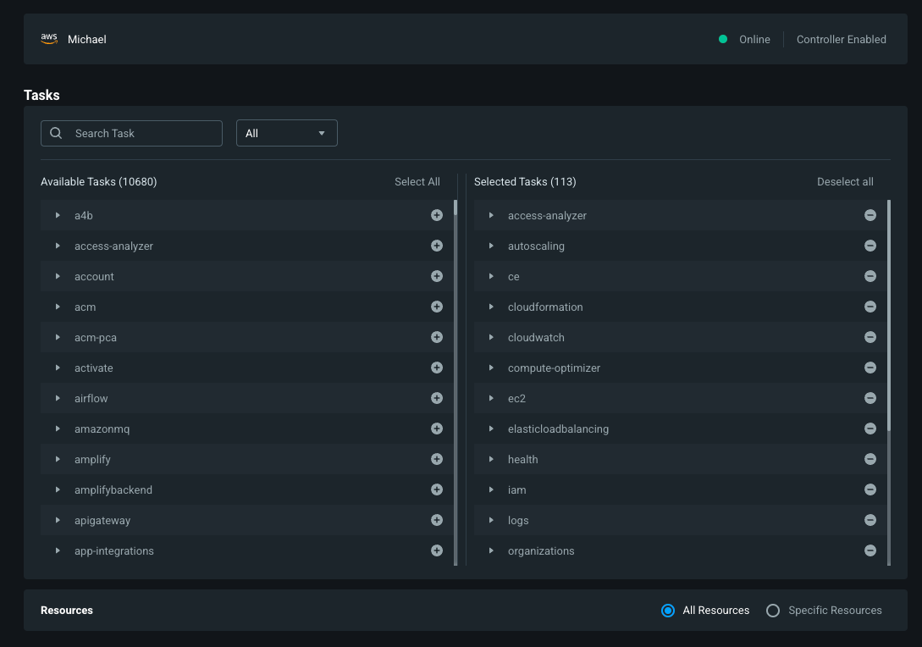
Configuring EPM JIT for Super Identities
Validate that the authorization system shows Controller Enabled
Without Controller Enabled, EPM cannot manage JIT access for users
The pre-selected tasks on the right will be the tasks that EPM has detected your Super Identity has used recently
Since super identities may need all permissions, you can optionally choose to add more
Choose Select All or individual permissions

Slide 17
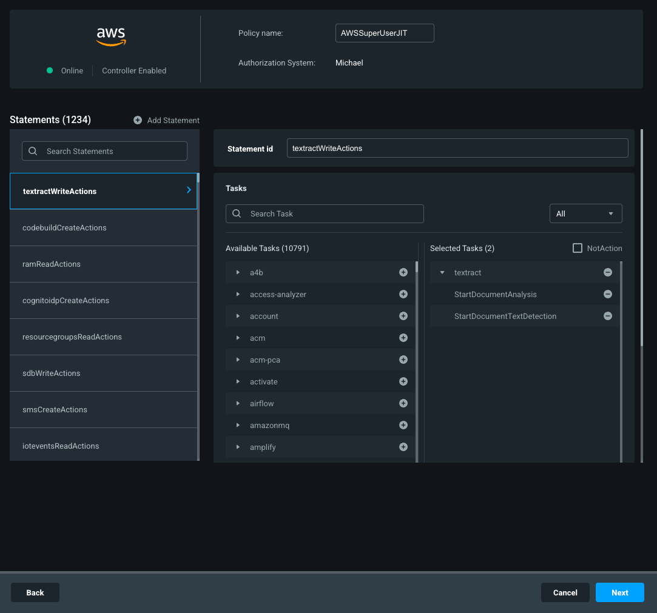
Configuring EPM JIT for Super Identities
Provide a policy name (AWS) or role name

Slide 18
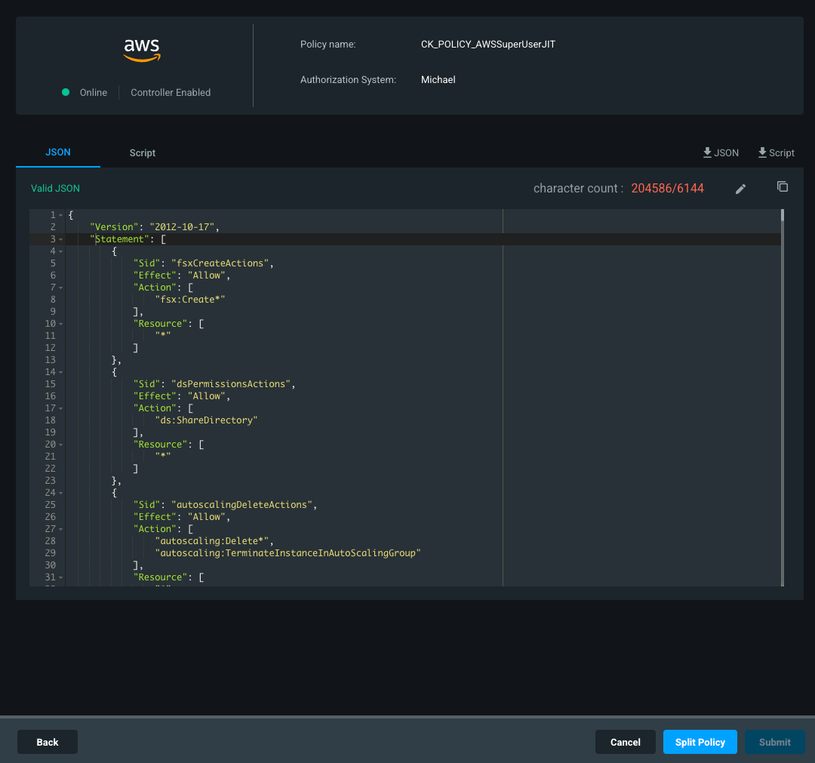
Configuring EPM JIT for Super Identities
If the policy is very large then you’ll need to create it using the Split Policy option:
Finally, click Submit
It will take several minutes for the policies to be created

Slide 19
Review inactive identities
Identities with granted, but not used privileges create imminent risk to your environment
Review if any identities need to retain permissions, but just use them sparingly, such as break glass accounts or apps
Filter these out of your alerts when you set them up later
Revoke all permissions for unused identities
Alternatively, revoke all write permissions for those identities
Start with High PCI, then Medium PCI, then Low PCI identities

Slide 20
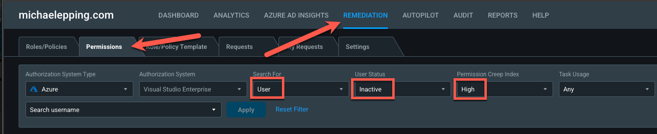
Remediating Inactive Identities
Navigate to Remediation → Permissions
Choose your Authorization System and filter
Filter for User, Group, Application, etc.
Filter User Status as “Inactive”
Filter for the PCI risk level, typically starting with High

Slide 21
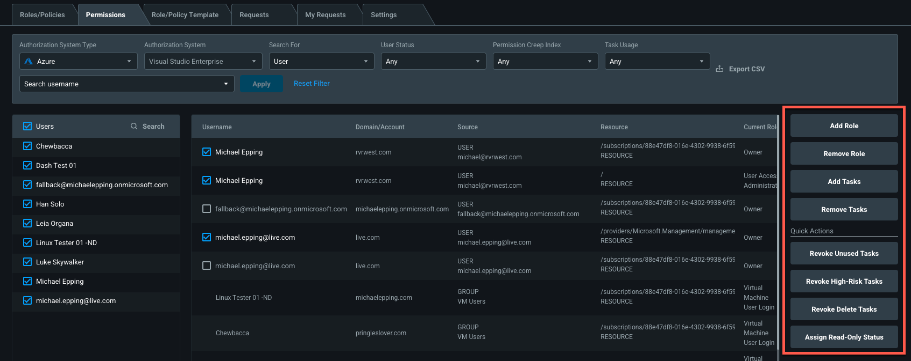
Remediating Inactive Identities
Choose the inactive identities that you would like to remediate
Choose the proper action on the right hand side. Recommended Actions:
Revoke Unused Tasks
Revoke High-Risk Tasks
Revoke Delete Tasks
Validate identities are truly inactive before invalidating permissions/tasks

Slide 22
Right-size active identity permissions (overprovisioned active identities)
Identify patterns for permissions and create custom roles if needed
Assign those baseline roles to overprovisioned identities
Start with identities that have a High PCI score

Slide 23
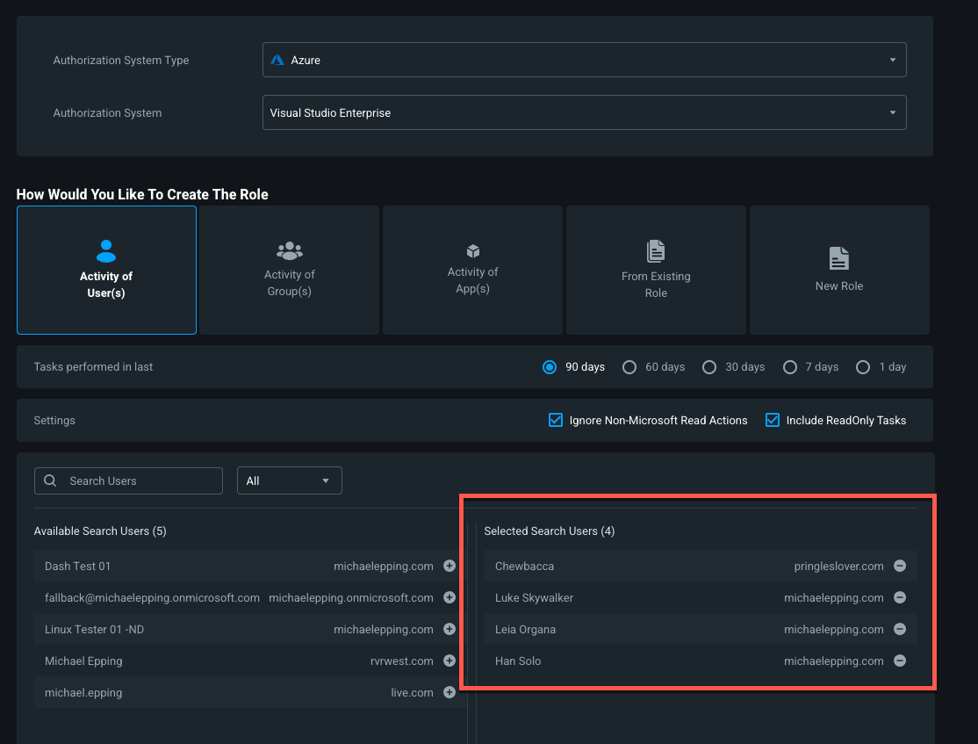
Right-size active identity permissions (overprovisioned active identities)
Identify a team or group of users you want to right-size permissions for. For example, the admins/devs for a web service
Recommended approach:
Create a new role based on what the team currently does
Go to Remediation → Roles/Policies → Create Role/Policy
Select the users from the team you’re working with:

Slide 24
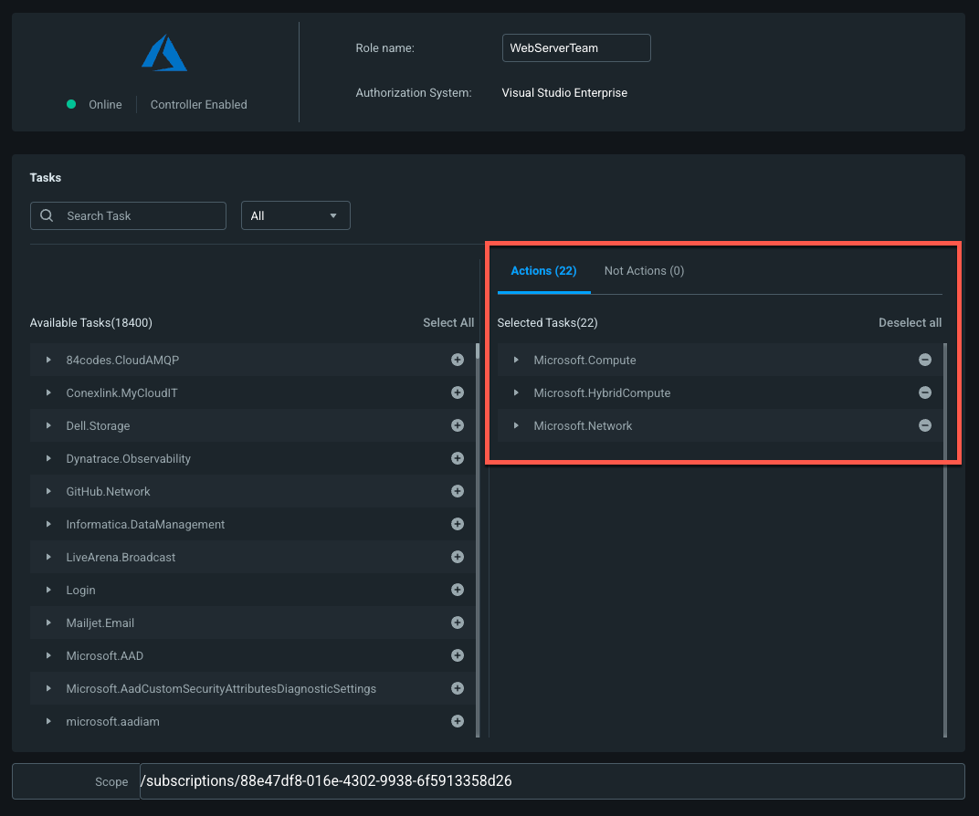
Right-size active identity permissions (overprovisioned active identities)
Validate the permissions in the new role
Add any missing permissions the team may need
Create the new role
Revoke existing permissions from the team
Going forward, these users should request the now right-sized permissions via EPM

Slide 25
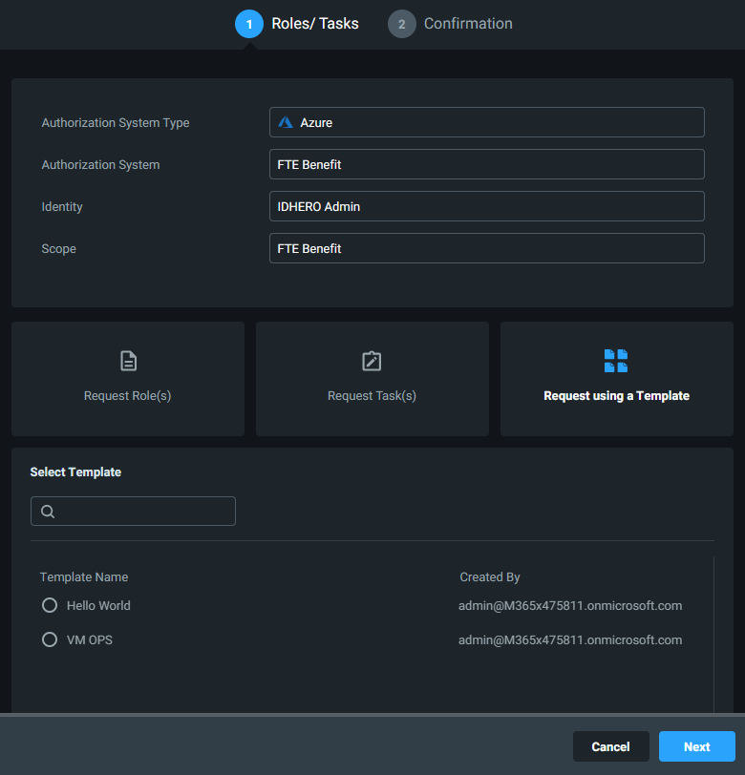
Implement Permissions On-Demand
Elevation of permissions can be based on a built-in or custom role, preconfigured permissions template, or even specific granular permissions.
Suggested Guiding Principles:
No user shall have delete permissions unless they explicitly request them, they are approved, and they are time-bound
High privileged access is only granted through just enough permissions and just-in-time access
Users may request recurring daily, weekly, or monthly permissions that are time-bound with approval
Use Templates where possible
Best practice: Configure Just-in-time for all privileged roles

Slide 26
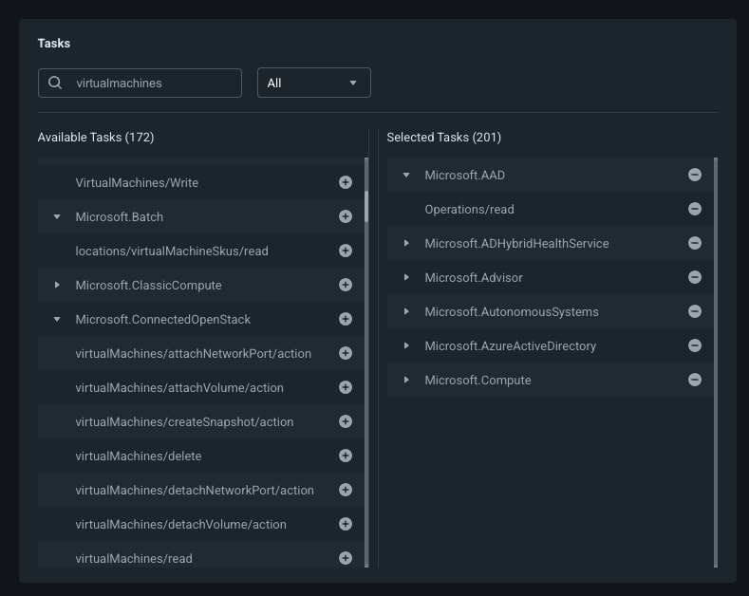
Implement Permissions On-Demand
Create templates
Templates let you create sets of permissions for users to request
For example, VM Admins in Azure may need to request multiple permissions within Microsoft.Compute, so configure a template with that set of permissions and any others they may want to request:

Slide 27
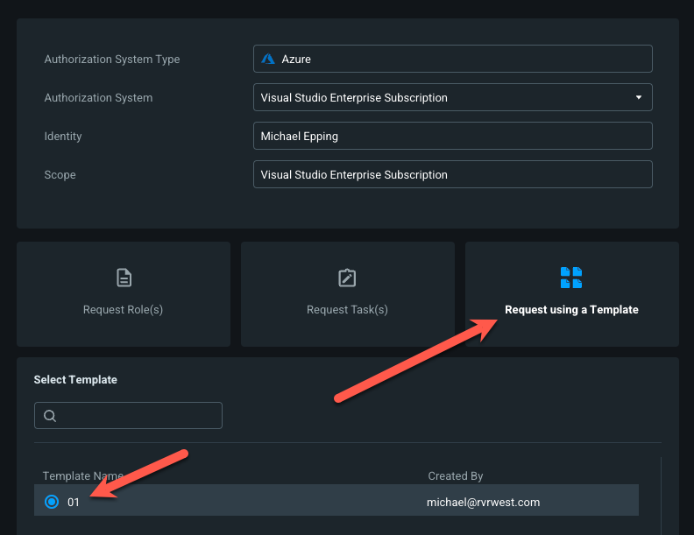
Implement Permissions On-Demand
Request Permissions
When the VM Admin goes to request permissions they can do so using the template
This reduces the need for them to need to know which individual permissions they may need

Slide 28
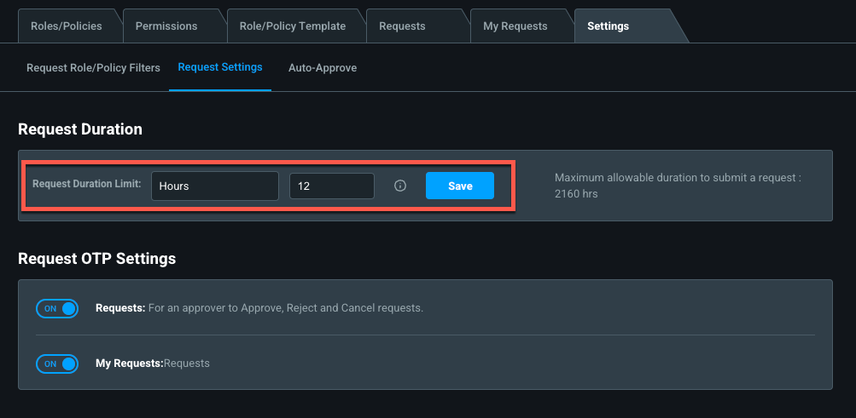
Implement Permissions On-Demand
Configure Request Settings
Recommended:
Configure a maximum request duration that aligns with your longest change window(s)

Slide 29

Day 60 Remediations: Permissions Creep Index

Slide 30
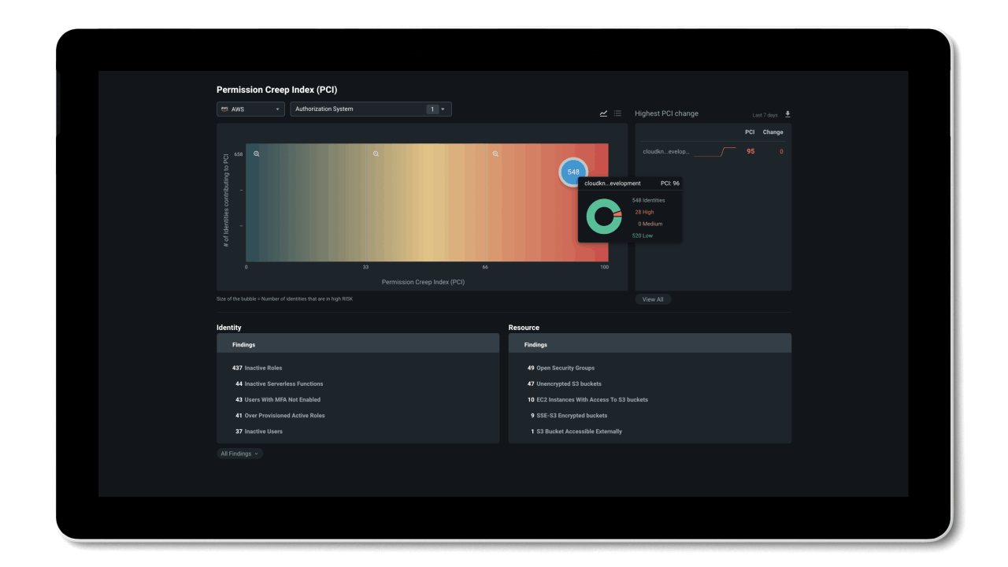
Permission Creep Index (PCI):
A single metric that evaluates the gap between permissions granted and permissions used.

Slide 31
What does PCI (Permission Creep Index) identify?
The number of identities (human and non-human) who have been granted high-risk permissions but aren't using them.
The number of identities who contribute to the permission creep index (PCI) and where they are on the scale.

Slide 32
The PCI heat map (1/2)
The Permission Creep Index heat map shows the overall calculated permissions gap created by high-risk permissions given to identities but not used. It shows:
Identities who were given access to high-risk permissions but aren't actively using them. High-risk permissions include the ability to modify or delete information in the authorization system.
The number of resources an identity has access to, otherwise known as resource reach.
The high-risk permissions coupled with the number of resources an identity has access to, produce the score seen on the chart. The PCI Trend graph shows you the historical trend of the PCI score over the last 90 days.

Slide 33



The PCI heat map (2/2)
Permissions are classified as high, medium, and low.
High (displayed in red) - The score is between 68 and 100. The identity has access to many high-risk permissions they aren't using and has high resource reach.
Medium (displayed in yellow) - The score is between 34 and 67. The identity has access to some high-risk permissions that they use or have medium resource reach.
Low (displayed in green) - The score is between 0 and 33. The identity has access to few high-risk permissions. They use all their permissions and have low resource reach.
The PCI Trend graph shows you the historical trend of the PCI score over the last 90 days.

Slide 34
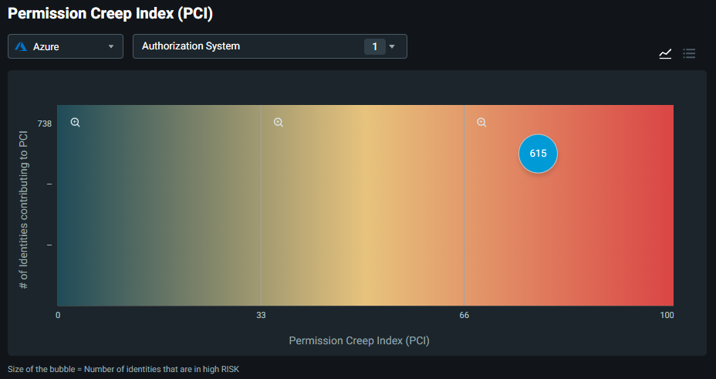
Each bubble displays the number of identities that contribute to the PCI score. High-risk refers to the number of identities that have permissions which exceed their normal or required usage.

Slide 35
Understanding the data
View identity findings
The Identity section below the heat map on the left side of the page shows all the relevant findings about identities, including inactive, overprovisioned active, serverless functions and other.
View resource findings
The Resource section below the heat map on the right side of the page shows all the relevant findings about your resources. For example, data that is publicly accessible, or an open network security group.

Slide 36
Common Identity findings
Inactive Identities
Identities that haven’t performed any* action during the last 90 days**.
Super Identities
Identities that have been given access equivalent to “root”.
Inactive serverless functions
Inactive groups
* Azure Resource Manager does not track read operations
** Given Entra Permissions Management was running for at least 60 days

Slide 37
Common resource findings
Open network security groups
Data exposed publicly to the Internet (Azure Blob Storage, AWS S3 Bucket or GCP Storage Bucket)
Data encrypted with provider managed keys only (not customer managed keys)

Slide 38
Recommendations
Set aside time to regularly look at PCI
Capture the current state of the PCI score so you can compare it when we’re done with the POC
Use PCI to determine identities with biggest blast radius, target those first

Slide 39
Where do we go from here?
Continue onto Part 5, Automation and Alerts

Slide 40

Thank you!

